Slide 1
JavaScript for Web Warriors, 7e Chapter 6: Enhancing and Validating Forms

Slide 2
Chapter Objectives (1 of 2)
By the end of this chapter, you should be able to:
Use JavaScript to reference forms and form elements.
Retrieve values from selection lists.
Retrieve values from option buttons.
Format numeric values and currency values based on local standards.
Write scripts that respond to form events.
Store values in hidden fields.
Notes:
Instructions: Briefly review with students the major concepts you will be covering during this class. There is one objective for every major A-head section of the chapter.

Slide 3
Chapter Objectives (2 of 2)
By the end of this chapter, you should be able to:
Understand how web forms are submitted for validation.
Validate web form fields using customized tools.
Test a field value against a regular expression.
Create a customized validation check for credit card data.
Manage the form validation process.
Notes:
Instructions: Briefly review with students the major concepts you will be covering during this class. There is one objective for every major A-head section of the chapter.

Slide 4
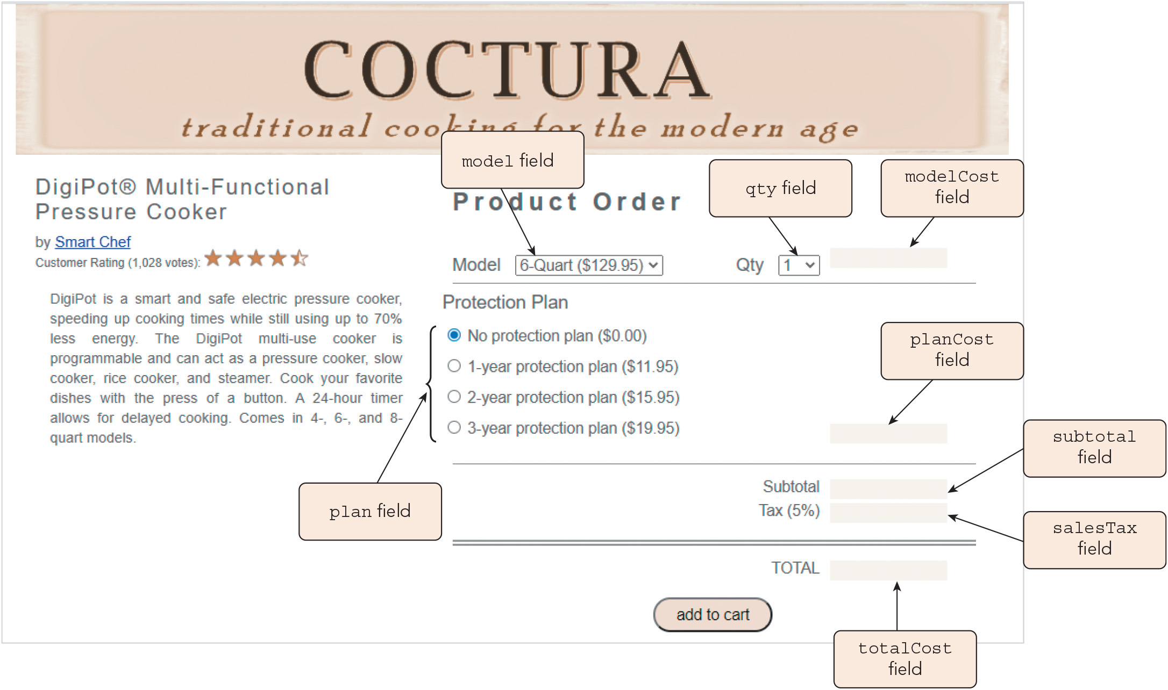
Exploring Forms and Form Elements (1 of 5)
Figure 6-1 Product order form

Slide 5
Exploring Forms and Form Elements (2 of 5)
The forms collection
JavaScript organizes forms into the HTML collection: document.forms
Syntax for referencing, where n is the index or fname is the value of the form's name attribute: document.forms[n] document.forms[fname] document.forms.fname
Working with form elements
Organized into the HTML collection: form.elements
Syntax for referencing fields, where ename is the value of the name attribute: form.elements[ename] form.elements.ename
Reference the associated control using the document.getElementById() method

Slide 6
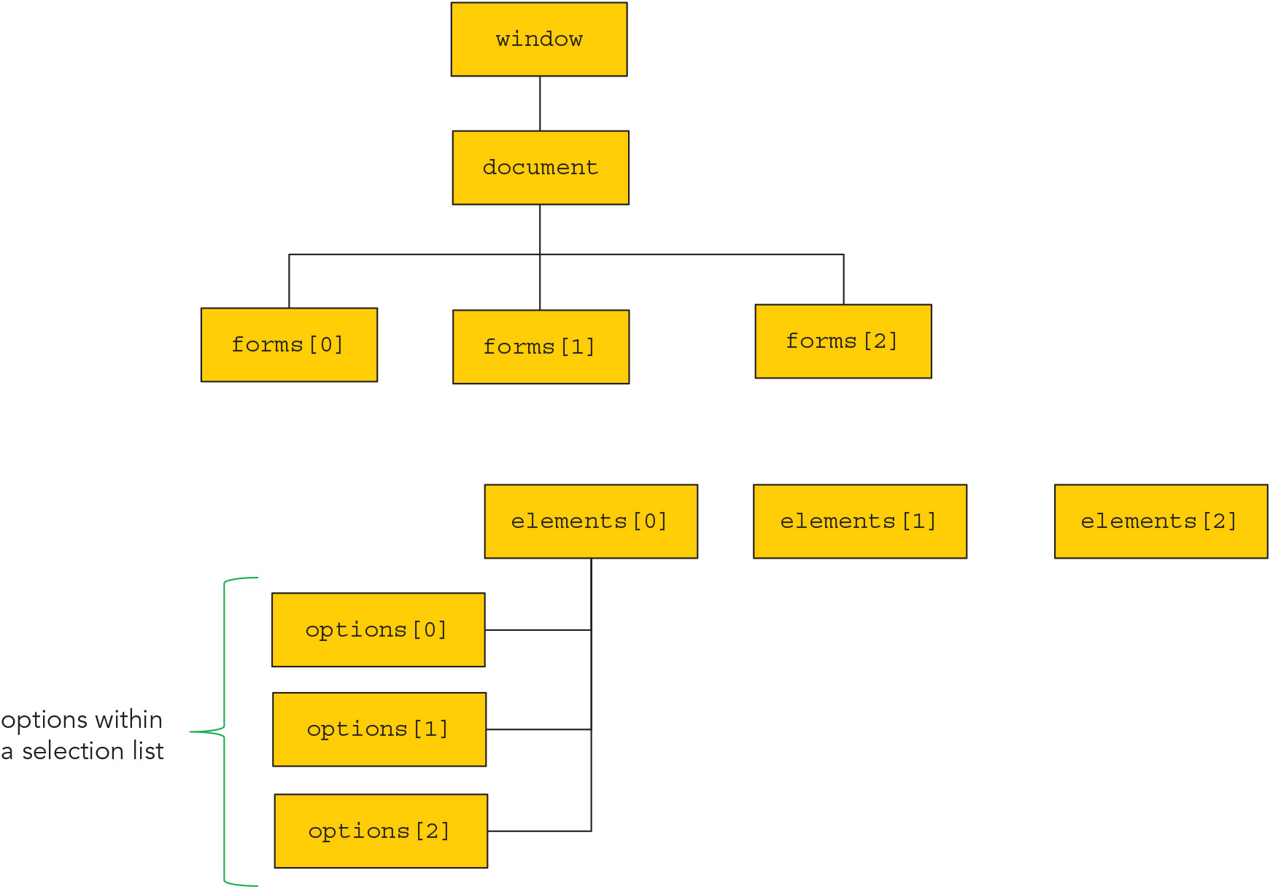
Exploring Forms and Form Elements (3 of 5)
Figure 6-3 Web form hierarchy

Slide 7
Exploring Forms and Form Elements (4 of 5)
Properties and methods of input elements
Every attribute associated with the HTML <input> tag is mirrored by a JavaScript property
Sample statement to set the value of the username field within the orderForm web form: document.orderForm.username.value = "John Smith";
Navigating between input controls
A form control receives the browser's focus when it becomes active
The element.focus() method gives focus to a form element
The element.blur() method removes focus from an element without reassigning it

Slide 8
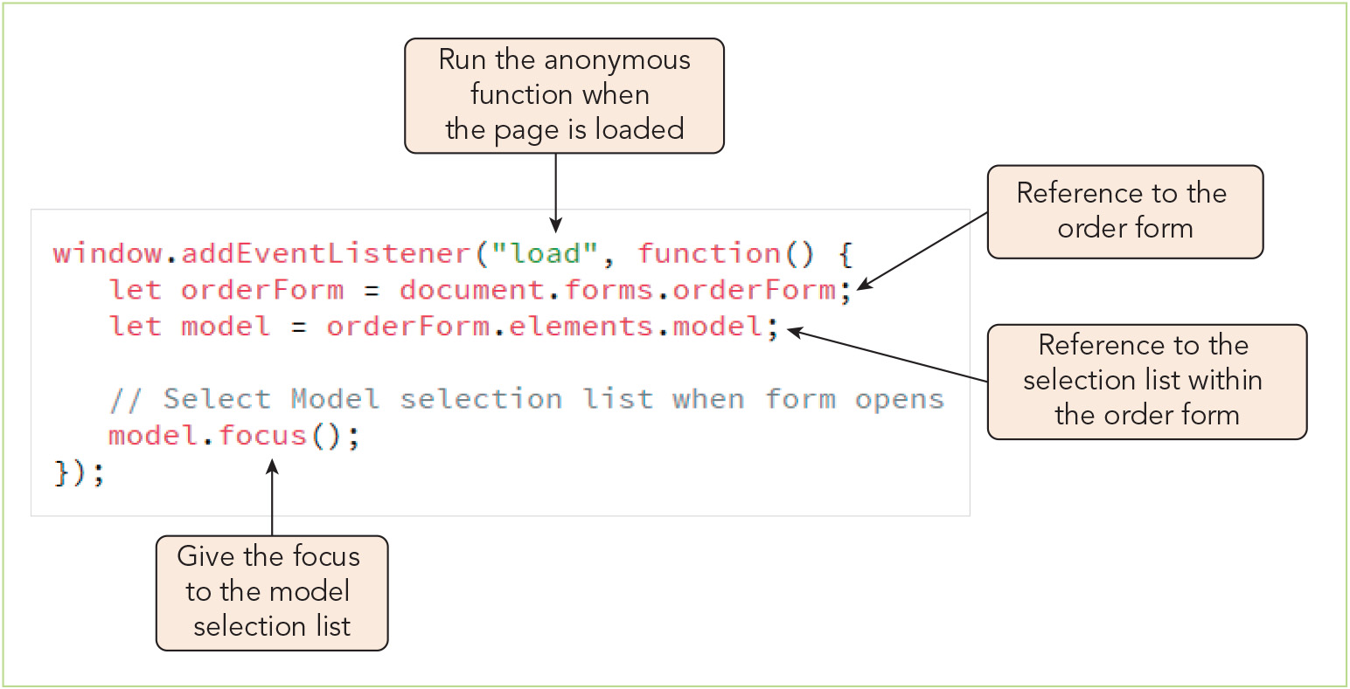
Exploring Forms and Form Elements (5 of 5)
Figure 6-5 Giving the focus to the Model selection list

Slide 9
Working with Selection Lists (1 of 4)
Property or Method | Description
select.length | The number of options in the selection list, select
select.multiple | Returns true if more than one option can be selected from the list
select.name | The selection list field name
select.options | The object collection of the selection list options
select.selectedIndex | The index number of the currently selected option
select.size | The number of options displayed in the selection list
select.add(option) | Adds option to the selection list
select.remove(index) | Removes the option with the index number, index, from the selection list

Slide 10
Working with Selection Lists (2 of 4)
Property or Method | Description
option.defaultSelected | Returns true if option is selected by default
option.index | The index number of option within the options collection
option.selected | Returns true if the option has been selected by the user
option.text | The text associated with option
option.value | The field value of option

Slide 11
Working with Selection Lists (3 of 4)
To return the value from a selection list field:
Determine which option was selected using the selectedIndex property
Returns -1 if no option is selected
Reference the value property of the selected option
Sample code for returning the cost of the product chosen from the model selection list: let mIndex = model.selectedIndex; let mValue = model.options[mIndex].value;
Selection list with multiple values
Create a for loop that runs through the options in the list, checking to determine whether the selected property is true

Slide 12
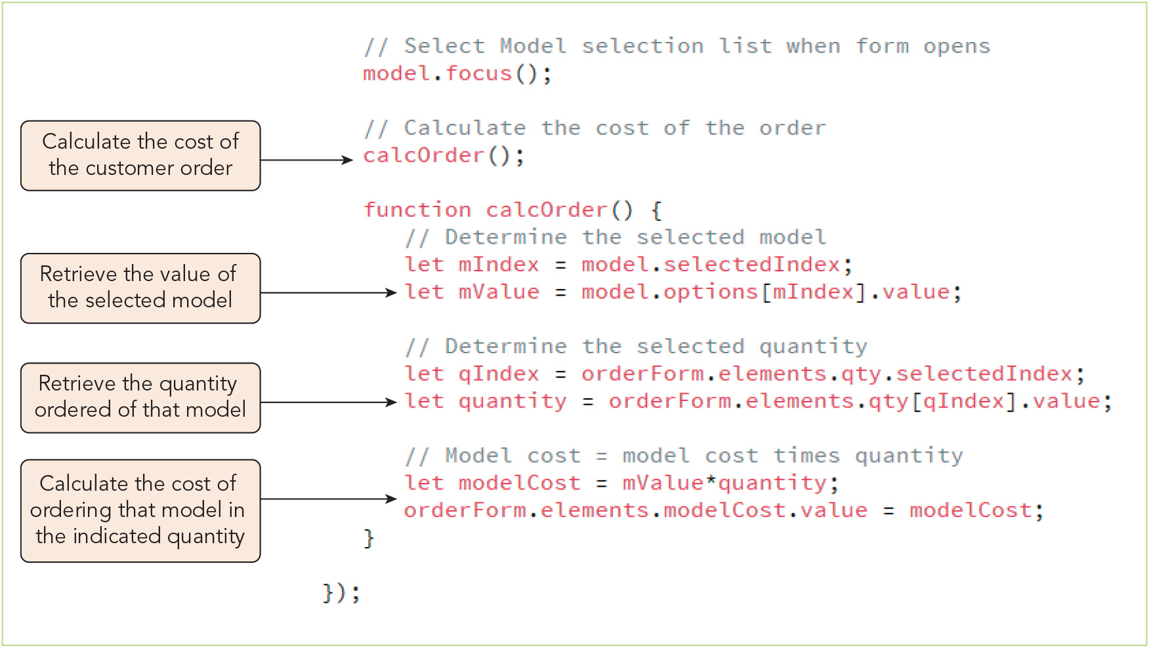
Working with Selection Lists (4 of 4)
Figure 6-8 Calculating the cost of models ordered

Slide 13
Working with Option Buttons (1 of 6)
Option (radio) buttons are grouped into a form.elements.options HTML collection when they share the same name attribute
Sample reference to the first option button for the plan field: document.forms.orderForm.elements.plan[0]
Property | Description
option.checked | Boolean value indicating whether the option button, option, is currently checked by the user
option.defaultChecked | Boolean value indicating whether option is checked by default
option.disabled | Boolean value indicating whether option is disabled or not
option.name | The field name associated with option
option.value | The field value association with option

Slide 14
Working with Option Buttons (2 of 6)
Locating the checked option
Sample for loop that stores the value of the selected option in the planValue variable: let orderForm = document.forms.orderForm; let plan = orderForm.elements.plan; for (let i = 0; i < plan.length; i++) { if (plan[i].checked) { planValue = plan[i].value; break; } }
Sample code using the querySelector() method to retrieve the checked option's value: let planValue = document.querySelector('input[name="plan"]:checked').value;

Slide 15
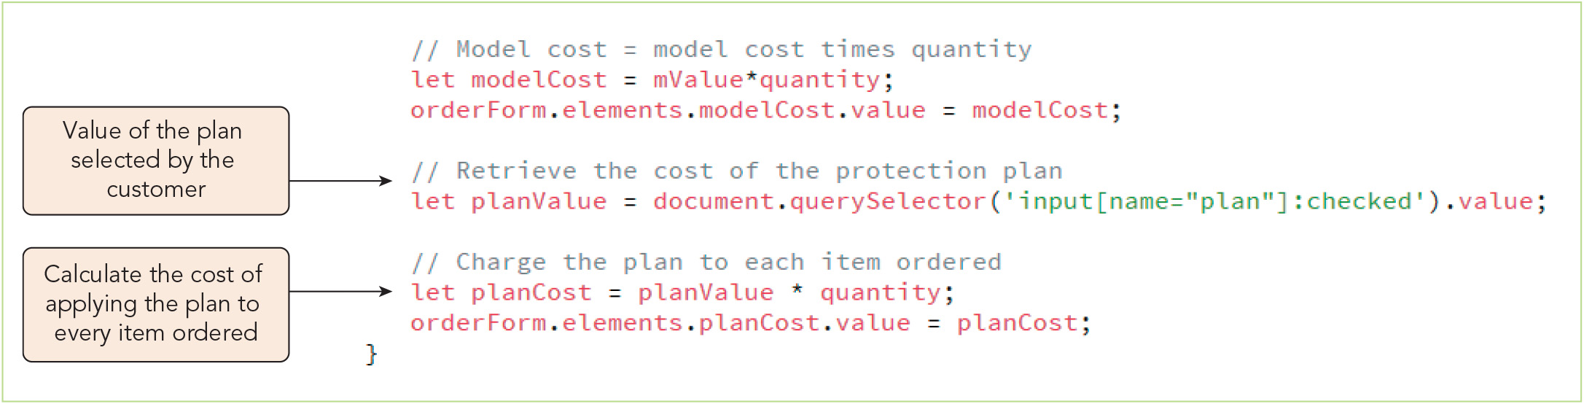
Working with Option Buttons (3 of 6)
Figure 6-11 Calculating the cost of the protection plan

Slide 16
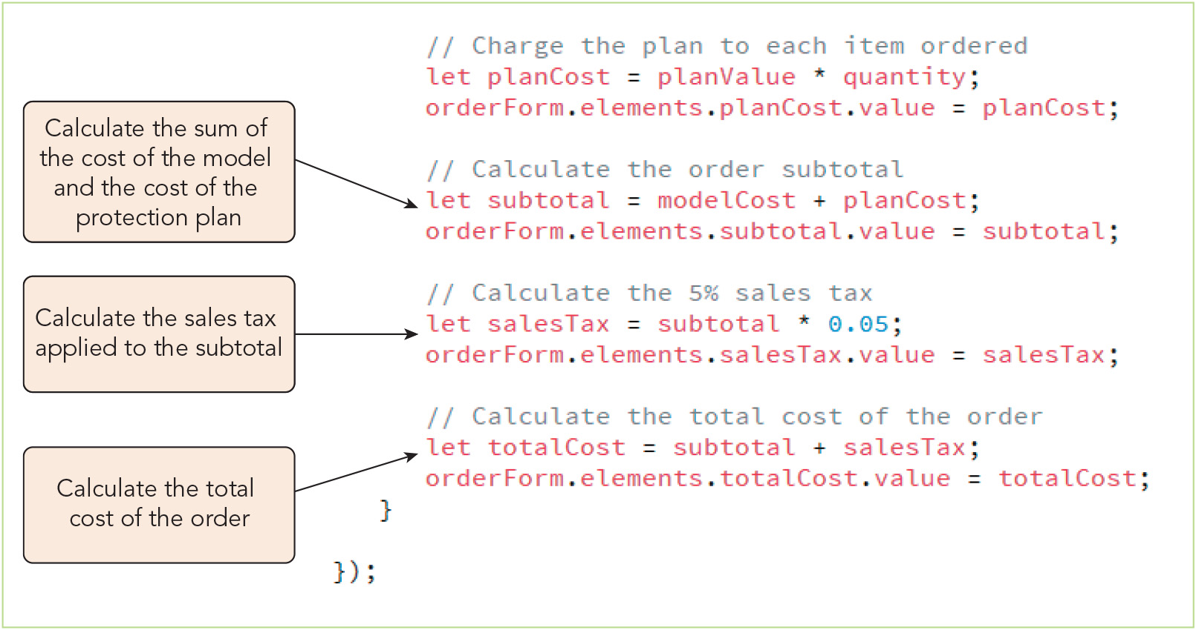
Working with Option Buttons (4 of 6)
Figure 6-12 Calculating the subtotal, sales tax, and total order cost

Slide 17
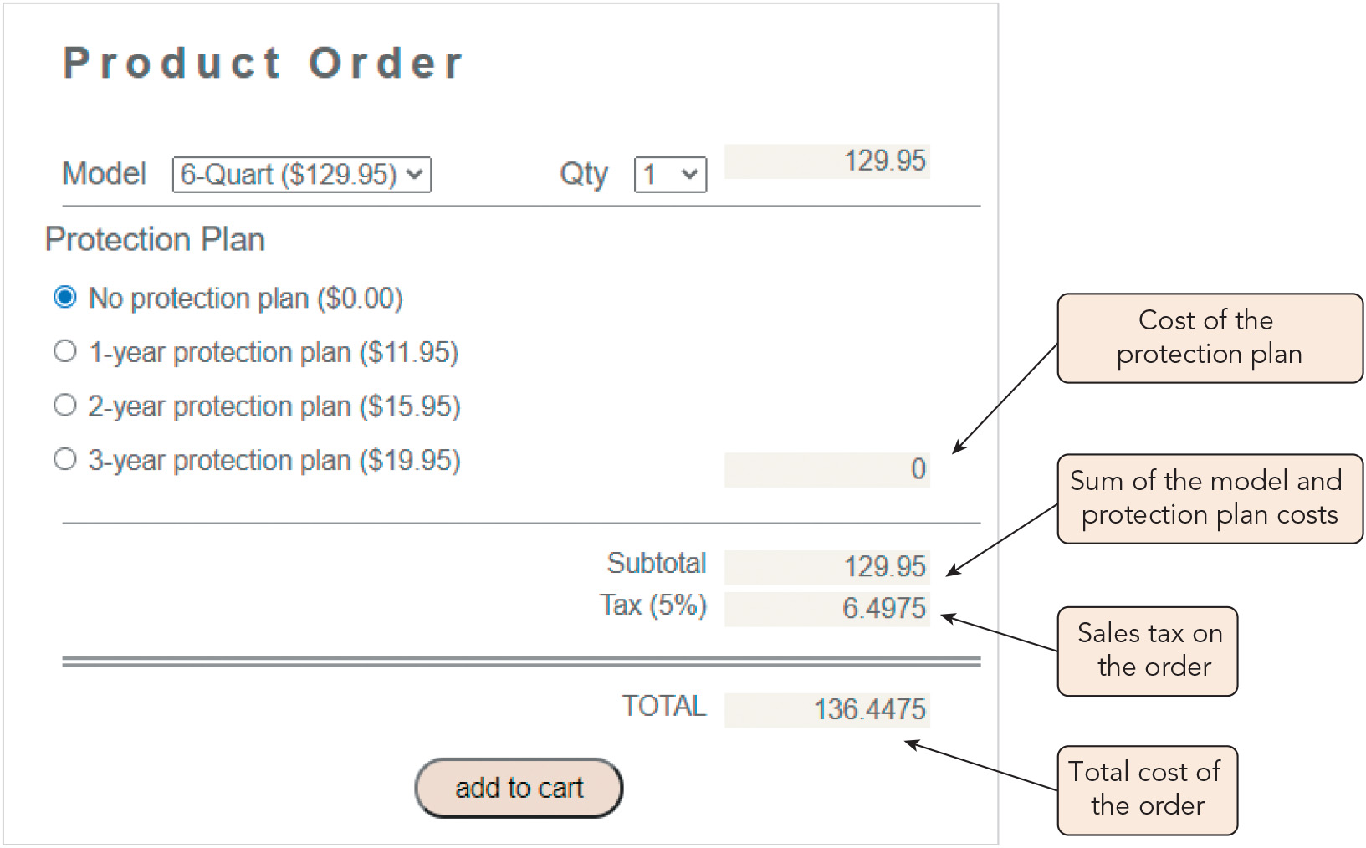
Working with Option Buttons (5 of 6)
Figure 6-13 Initial order calculations

Slide 18
Working with Option Buttons (6 of 6)
Accessing the option label
Text associated with the button is part of the <label> tag, not part of the <input> tag
Label is associated with the input control through its for attribute, which matches the input control's id attribute
JavaScript's labels node list for any input element: input.labels
Sample code to retrieve the label text for the No Protection Plan option button: let noProtection = document.getElementById("plan_0"); let planLabel = noProtection.labels[0].textContent;
Sample code to retrieve the label text for the selected option button: let plan = document.querySelector('input[name="plan"]:checked'); let planLabel = plan.labels[0].textContent;
HTML code in a label is retrieved using the innerHTML property

Slide 19
Activity 6.1: Knowledge Check
Compare the process of retrieving the value of an input box in a web form to that of retrieving the chosen value from a selection list.
How can you retrieve the value and the label for the option selected by the user from a group of radio buttons?
Notes:
Instructions:
Use the Knowledge Check questions to periodically pose a question to students during class to gauge how well they can recall the material that was presented.

Slide 20
Activity 6.1: Knowledge Check Answers (1 of 2)
Compare the process of retrieving the value of an input box in a web form to that of retrieving the chosen value from a selection list. To retrieve the value of an input box, you can simply reference its value property. To retrieve the chosen value for a selection list, on the other hand, you must first identify the selection option used the field's selectedIndex property, and then reference the value property for the selected option. If the selection list allows multiple selections, then you must iterate through the options to store all the selected options in an array, then iterate over the array to extract the values.
Notes:
Instructions:
Use the Knowledge Check questions to periodically pose a question to students during class to gauge how well they can recall the material that was presented.

Slide 21
Activity 6.1: Knowledge Check Answers (2 of 2)
How can you retrieve the value and the label for the option selected by the user from a group of radio buttons? One method for retrieving the selected option's value is to iterate over the options to find the checked option, assign its value property to a variable, and then exit the loop. A second route is to call the querySelector() method on the document, passing in the CSS selector input[name="name"]:checked as the argument, and assign the value property of the returned reference to a variable. To retrieve the selected option's label text, you reference its index value in the labels node list for that input element (which will be 0 if each radio button has just one label). You can assign a reference to the checked input element [obtained using the querySelector() method] to a variable, then assign the value of thatVariable.labels[0].textContent to your label variable.
Notes:
Instructions:
Use the Knowledge Check questions to periodically pose a question to students during class to gauge how well they can recall the material that was presented.

Slide 22
Formatting Data Values in a Form (1 of 4)
The toFixed() method
Syntax to return a text string of a number rounded to n decimal places: value.toFixed(n)
Formatting values using a locale string
Syntax used to format numbers (or dates) with various options: value.toLocaleString(locale, {options})
Sample use of this method to apply local formatting from the user's computer: let total = 14281.478; total.toLocaleString(); // returns "14,281.478"
Sample code to format a number as U.S. currency: let total = 14281.5; total.toLocaleString("en-US", {style: "currency", currency: "USD"}) // returns "$14,281.50"

Slide 23
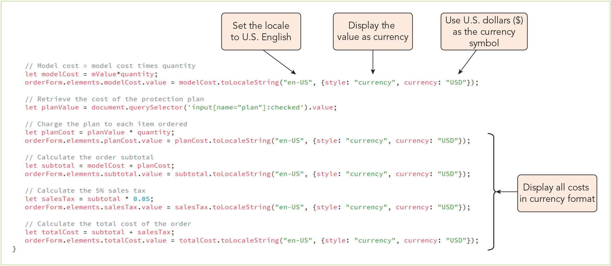
Formatting Data Values in a Form (2 of 4)
Figure 6-15 Applying the toLocaleString() method

Slide 24
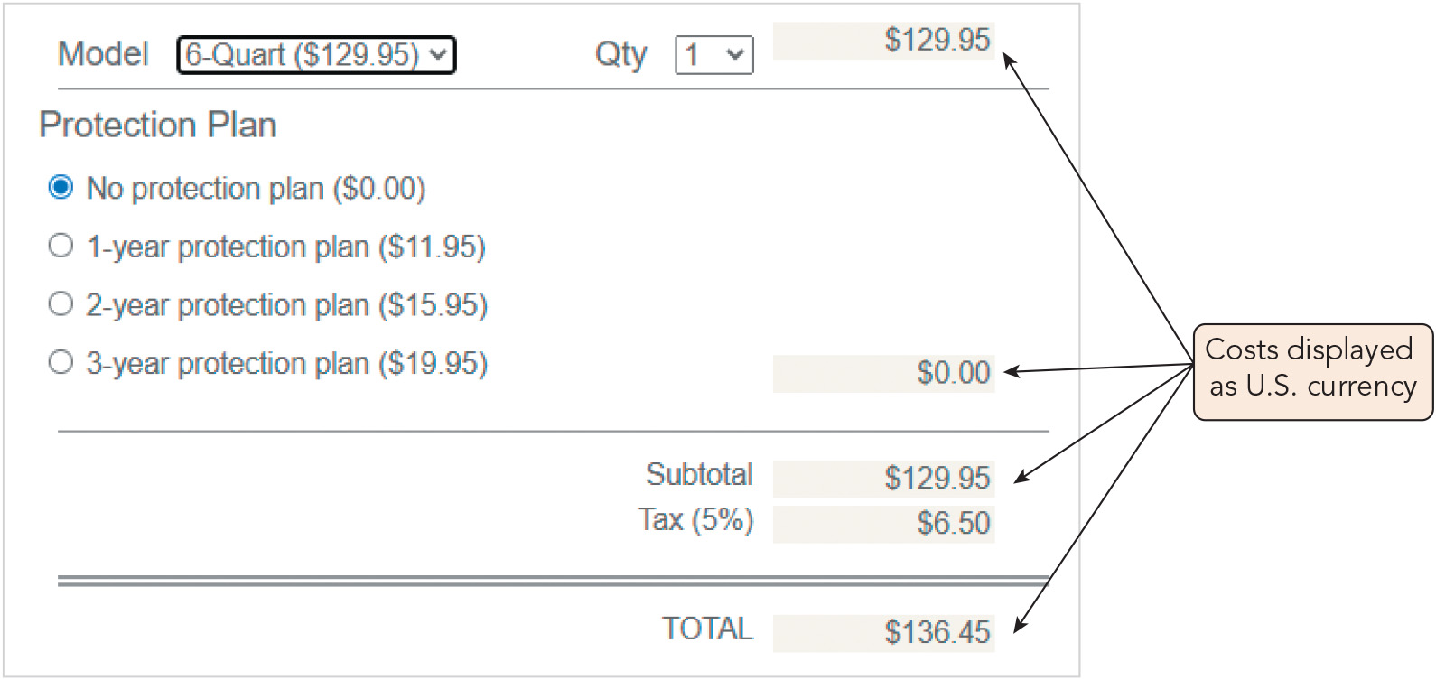
Formatting Data Values in a Form (3 of 4)
Figure 6-16 Displaying numeric values as currency

Slide 25
Formatting Data Values in a Form (4 of 4)
Making a website international friendly
Support international conventions
Avoid images that contain text strings
Make your layout flexible
Optimize your site for international searches
Provide currency conversion features
Account for cultural differences

Slide 26
Responding to Form Events (1 of 3)
Event Handler | Description
element.onblur | The form element has lost the focus
element.onchange | The value of element has changed, and element has lost the focus
element.onfocus | The element has received the focus
element.oninput | The element has received user input
element.oninvalid | The element value is invalid
form.onreset | The form has been reset
element.onsearch | The user has entered something into a search field
element.onselect | Text has been selected within the element
form.onsubmit | The form has been submitted

Slide 27
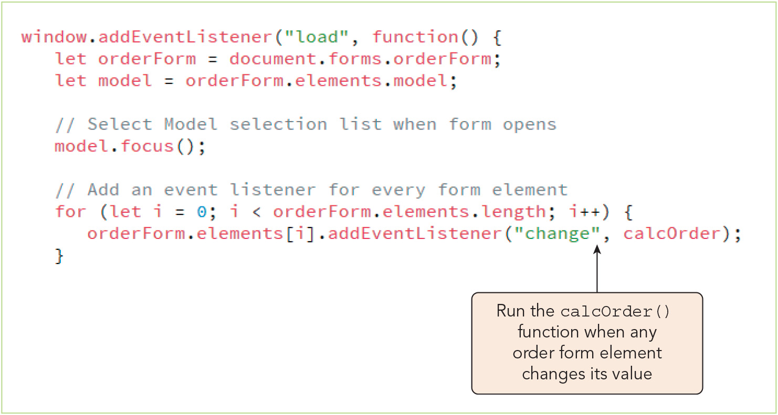
Responding to Form Events (2 of 3)
Figure 6-18 Adding event listeners to a form

Slide 28
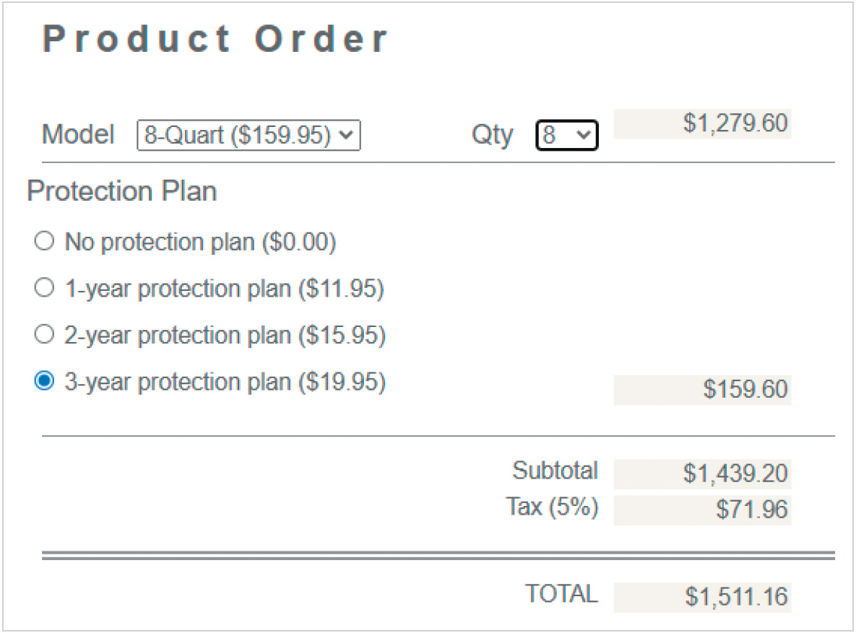
Responding to Form Events (3 of 3)
Figure 6-19 Order costs recalculated for different customer choices

Slide 29
Working with Hidden Fields (1 of 2)
Hidden fields are often used to make data available to the server processing a web form while hiding it from the user
Sample HTML code for a hidden field: <input type="hidden" id="modelName" name="modelName" />
Sample code to store data in a hidden field (mIndex is the index of the chosen option): orderForm.elements.modelName.value = orderForm.elements.model.options[mIndex].text;
Query string: a long text string containing field names and values from a web form

Slide 30
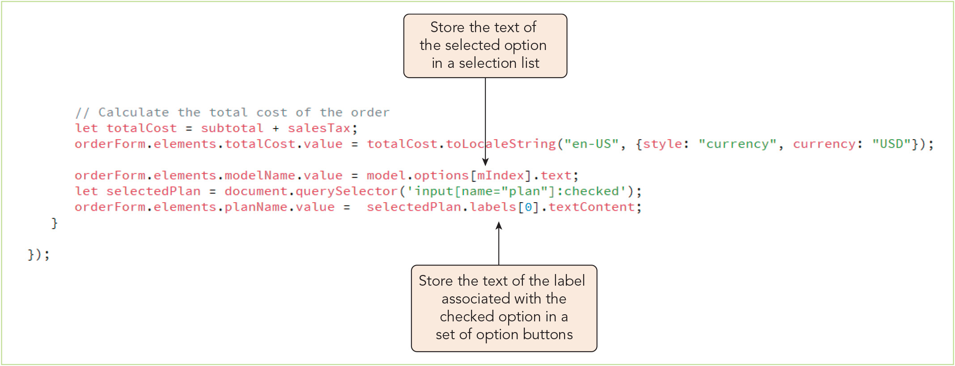
Working with Hidden Fields (2 of 2)
Figure 6-20 Setting the value of hidden fields

Slide 31
Exploring Form Submission
Actions within the browser when a submit button (which has the attribute type="submit") is activated:
Field values are checked for invalid data
If no invalid data is found, a submit event is fired
If no errors occur in form submission, a request is sent to the server or other resource handling the form data
Using the submit event
Use the form.submit() method to submit a form without validating data or firing the submit event of the form object
Resetting a form
Forms are reset when a user clicks a reset button
Can also be reset using the form.reset() method

Slide 32
Validating Form Data with JavaScript (1 of 11)
Validation: the process of checking the form for invalid data
Client-side validation is performed by the user's computer
Server-side validation is handled by the web server
Browser-based validation (native validation): validation derived from HTML attributes to restrict what data the user can enter and CSS style rules that highlight data entry errors
Sample HTML code to mark a required field: <input name="cardName" id="cardName" required type="text" />
Sample CSS style rule to highlight invalid data: input:invalid { background-color: rgba(221,147,148,0.2); }

Slide 33
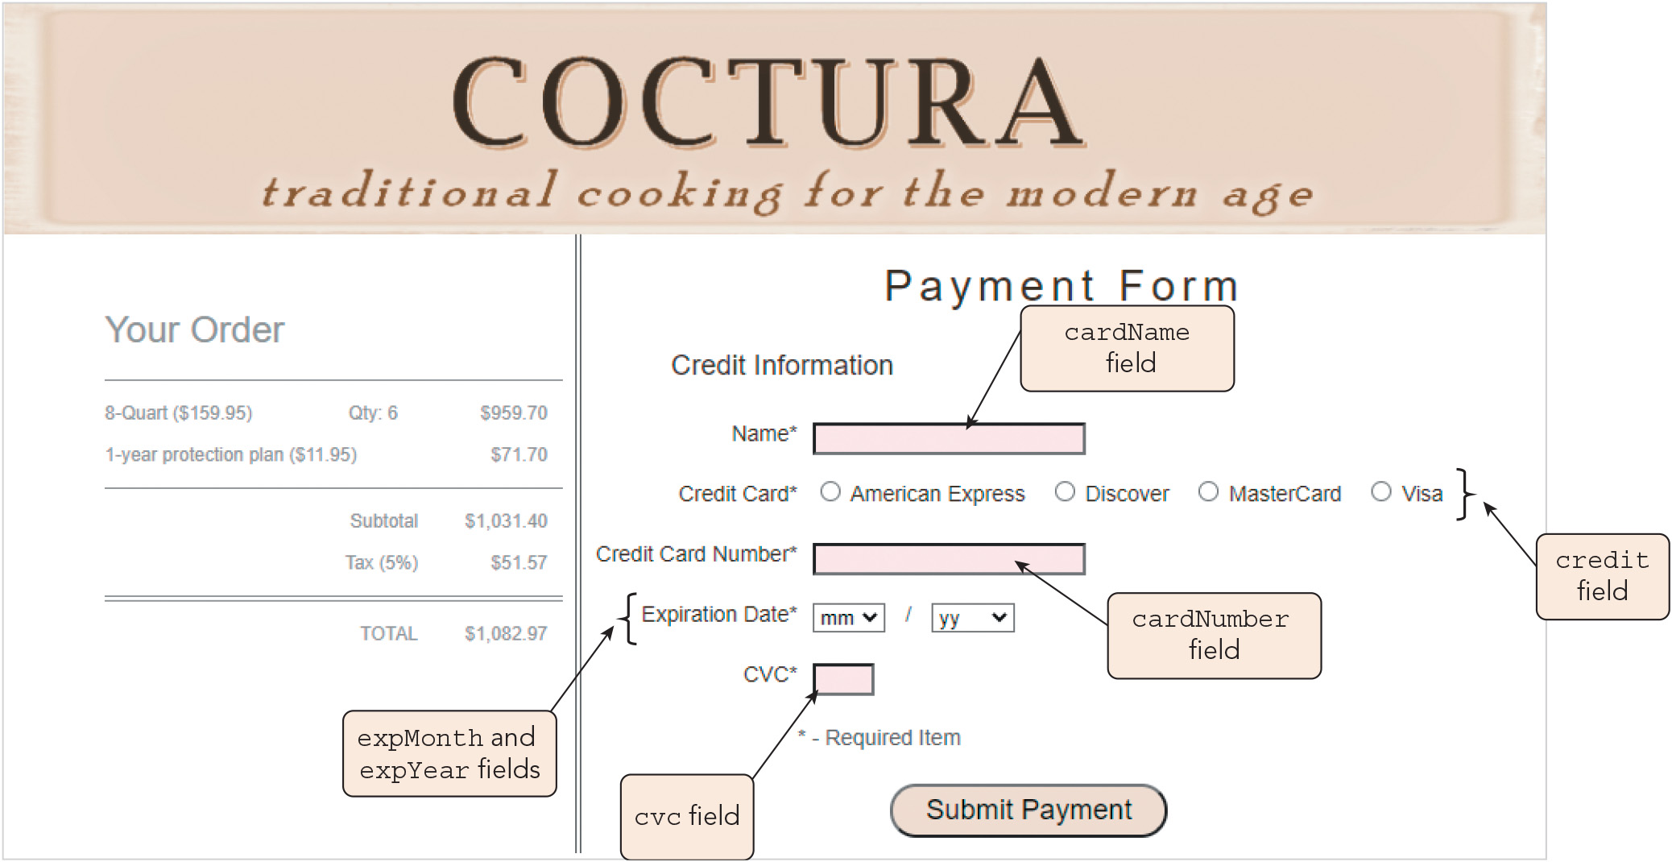
Validating Form Data with JavaScript (2 of 11)
Figure 6-22 Payment form

Slide 34
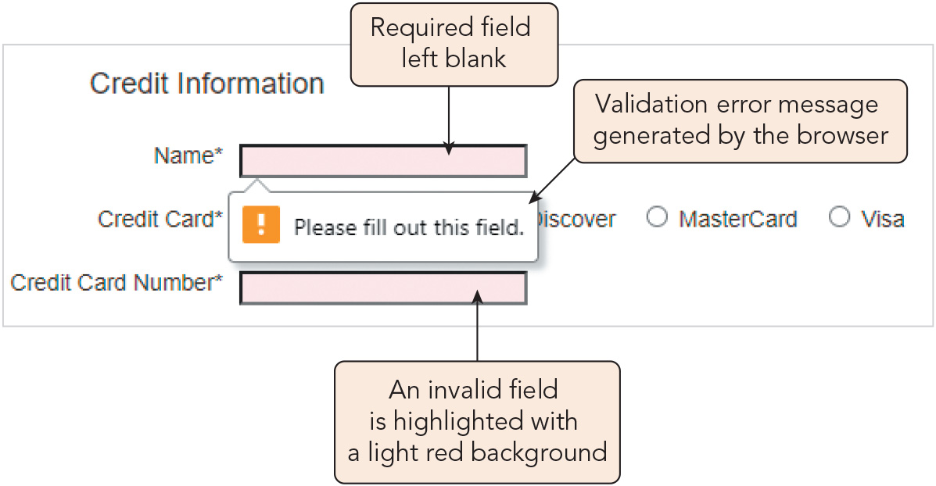
Validating Form Data with JavaScript (3 of 11)
Figure 6-23 Browser validation message and highlighting

Slide 35
Validating Form Data with JavaScript (4 of 11)
Limitations of browser-based validation:
Validation error message is generic
Validation tests are based on a single field value
Tests are limited to data field entries; cannot be used for calculated items or functions
Constraint Validation API: form validation properties and methods built into JavaScript
Used to supplement native browser tools
Working with the Constraint Validation API
The valid property for a field returns true if it contains valid data
The checkValidity() method returns true for valid data or returns false and fires an invalid event for invalid data
Invalid event: an event that occurs whenever the browser encounters a field whose value does not match the rules specified for its content

Slide 36
Validating Form Data with JavaScript (5 of 11)
Exploring the ValidityState object
The ValidityState object stores information about the cause of invalid data and is referenced with the expression element.validity
Syntax to check whether a field is invalid due to a specific validity state (e.g., tooLong or valueMissing): element.validity.ValidityState
Creating a custom validation message
Syntax: element.setCustomValidity(msg)
Can be used with an if else block that displays the custom message for a given invalid validity state or an empty string for a valid state

Slide 37
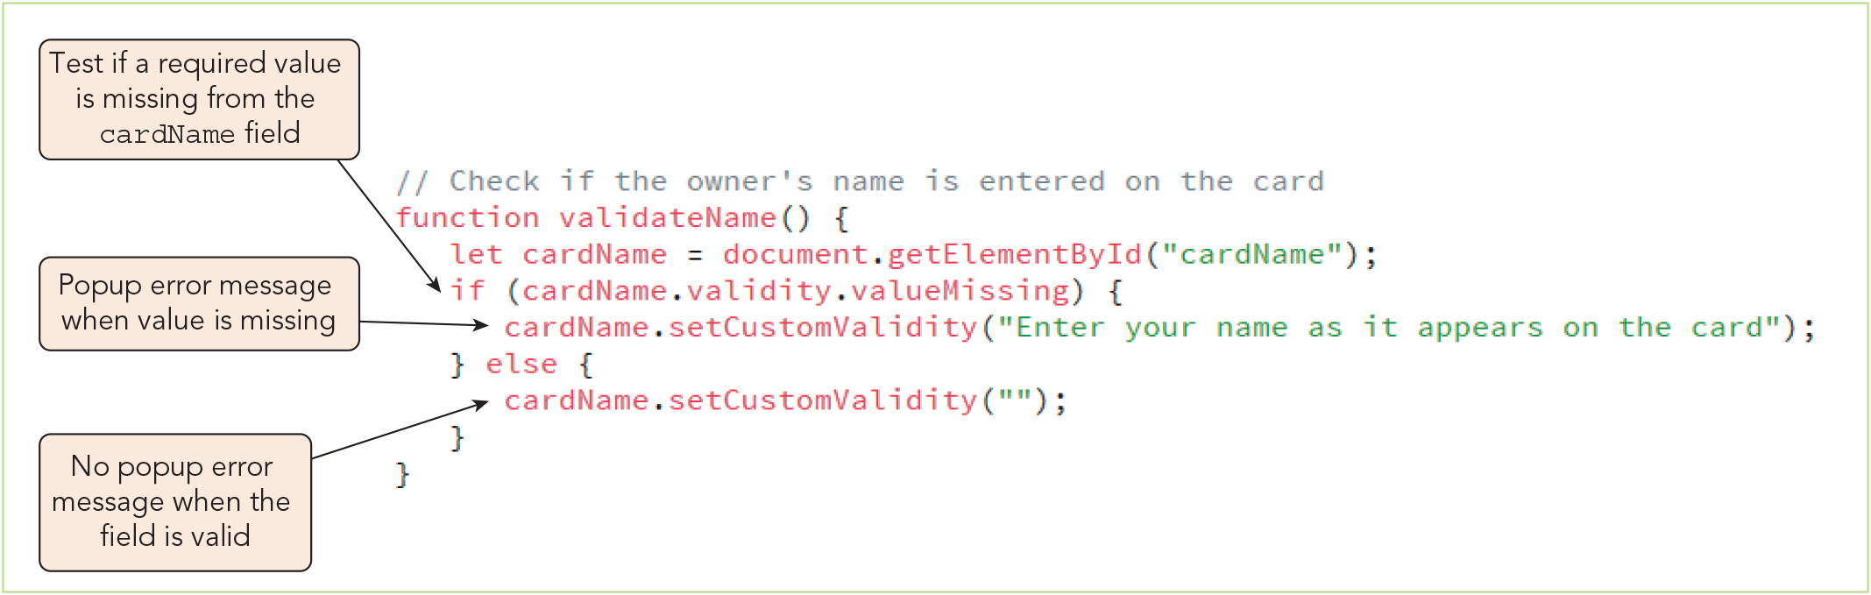
Validating Form Data with JavaScript (6 of 11)
Figure 6-27 Creating the validateName() function

Slide 38
Validating Form Data with JavaScript (7 of 11)
Responding to invalid data
Use event handlers or event listeners:
For the change event of an input control to check the validity of data upon entry
For the click event of of the form's submit button to check the validity of data on form submission
Validating data with pattern matching
Text string content can be validated against a regular expression, concise code describing the general pattern and content of the characters within a text string
Useful for numerical IDs with specific patterns, such as credit card numbers
Validating a selection list
If the user must change from a dummy option to a valid selection, you must instruct the browser to declare the field invalid if the dummy option's index is left selected

Slide 39
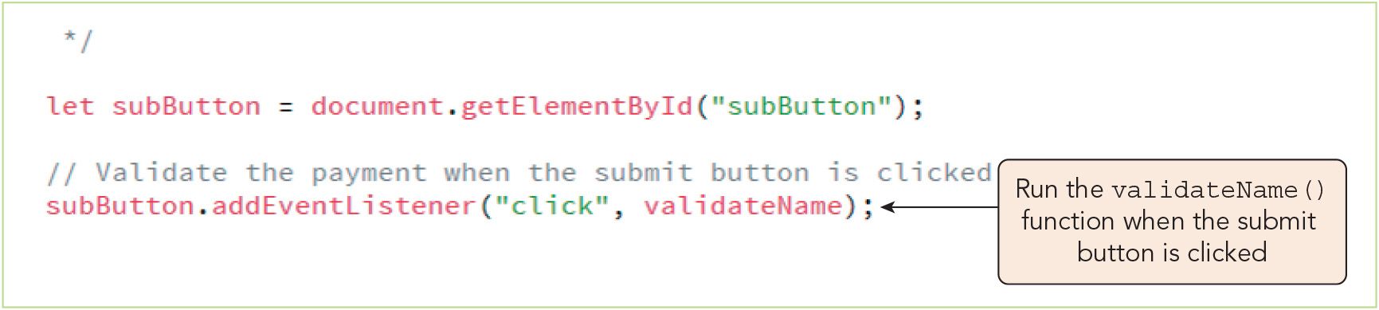
Validating Form Data with JavaScript (8 of 11)
Figure 6-28 Calling the validateName() function

Slide 40
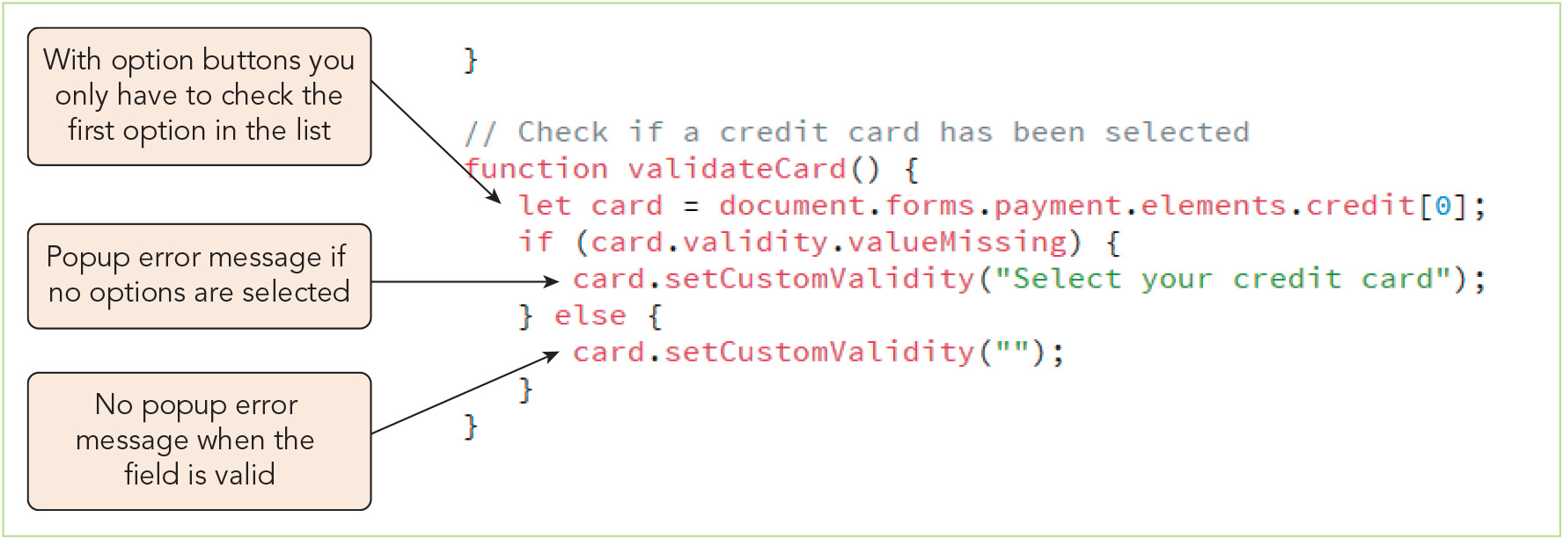
Validating Form Data with JavaScript (9 of 11)
Figure 6-30 Creating the validateCard() function

Slide 41
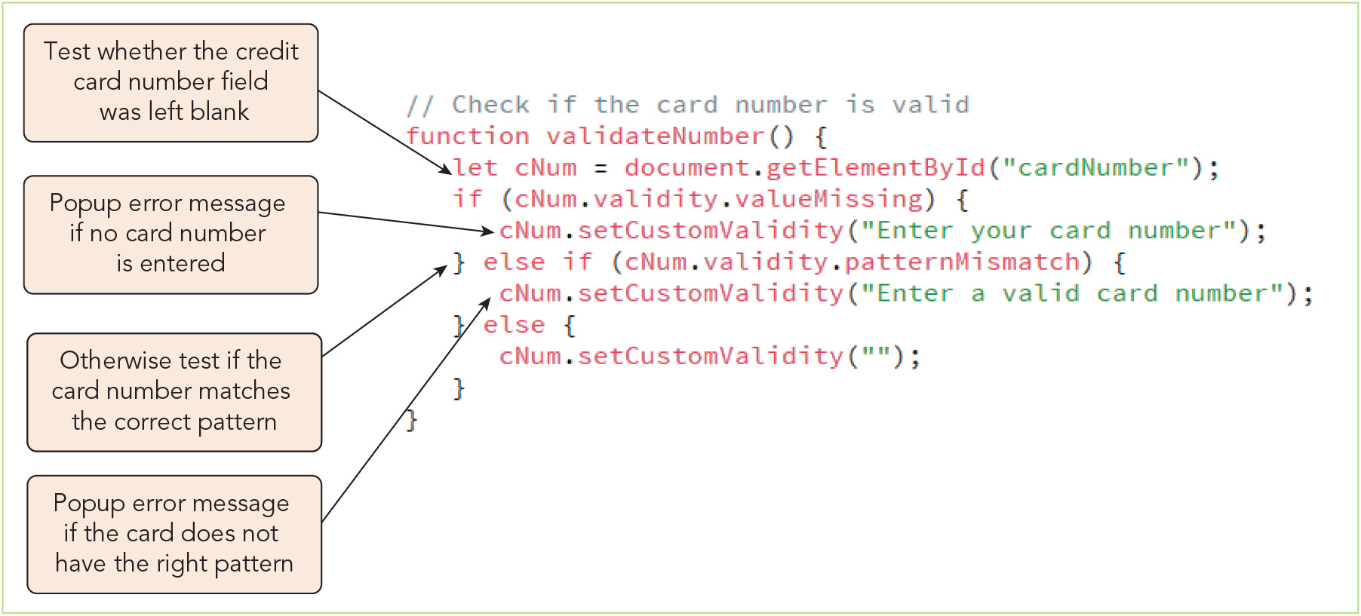
Validating Form Data with JavaScript (10 of 11)
Figure 6-31 Creating the validateNumber() function

Slide 42
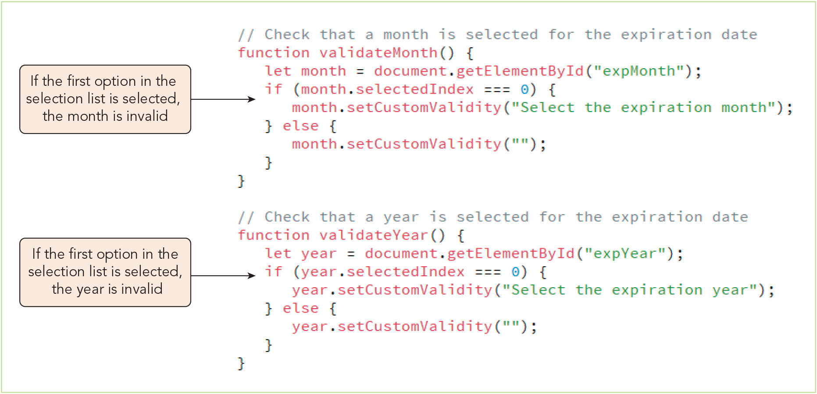
Validating Form Data with JavaScript (11 of 11)
Figure 6-33 Creating the validateMonth() and validateYear() functions

Slide 43
Activity 6.2: Think, Pair, and Share
Form pairs/groups of two to four class members.
As a group, choose a purpose/objective for which you might design a short web form—for example, scheduling an appointment, selecting a shirt to purchase, or leaving feedback about services received. Make a list of the fields that the form would require, including the type of input control that you would use to collect the information from the user.
Now that you have decided on the fields for your web form, plan how you would ensure that it would submit valid data for processing at the back end. For each field, write notes about the form(s) of validation that you would use and how you would handle invalid data entry by the user.
Notes:
Instructions:
Use the Think, Pair, Share activity to encourage students to solve problems collaboratively and to apply the real-world skill of evaluating, modifying, and debugging code created by another programmer.

Slide 44
Testing a Form Field Against a Regular Expression (1 of 2)
Syntax to check whether a text string conforms to a regular expression pattern: regExp.test(text)
Sample use of the test() method to check whether cardCVC's value is a 4-digit number: let cvc = document.getElementById("cvc"); let isValid = /^\d{4}$/.test(cvc.value)

Slide 45
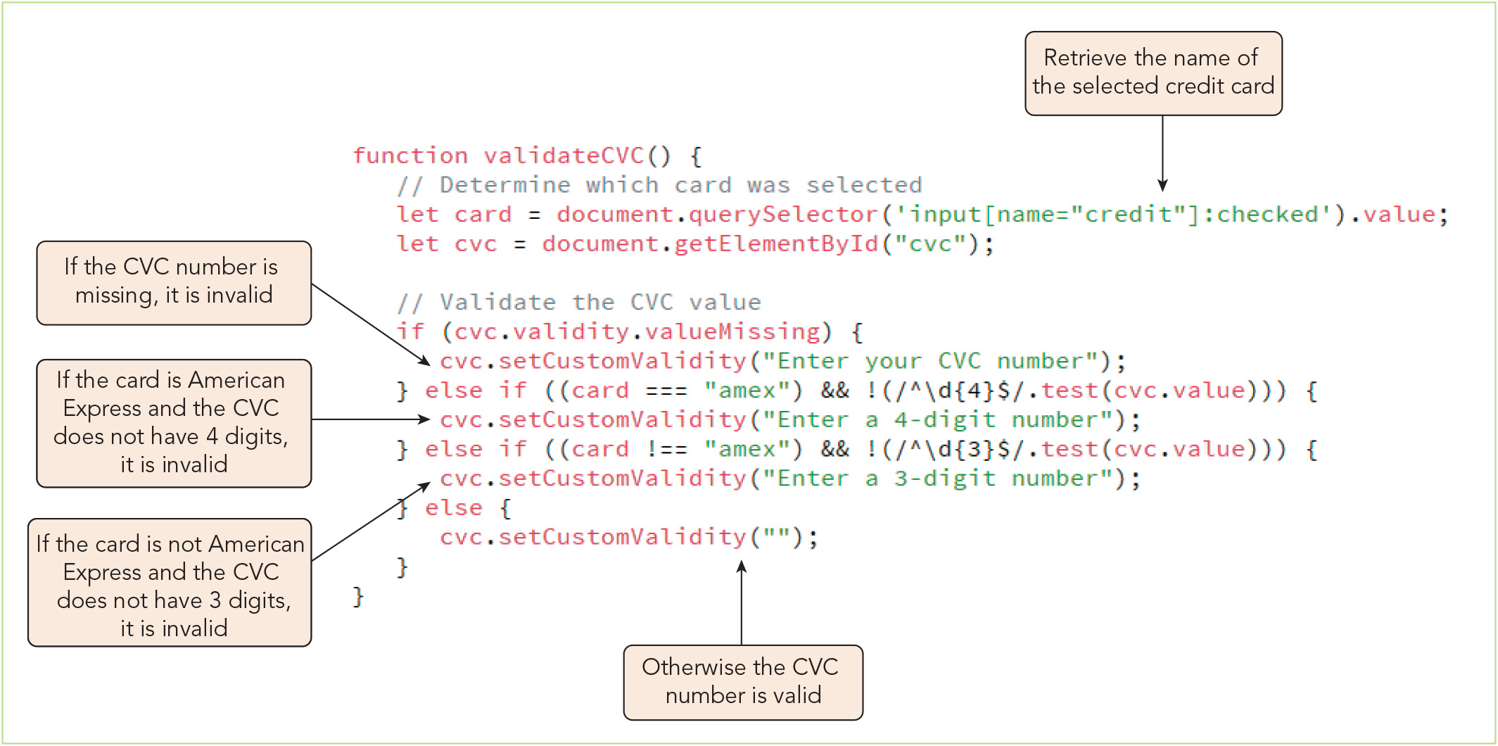
Testing a Form Field Against a Regular Expression (2 of 2)
Figure 6-34 Creating the validateCVC() function

Slide 46
Creating a Custom Validity Check (1 of 2)
Checksum algorithm: an algorithm that sums the digits of a number in a particular way and checks whether the sum satisfies specific mathematical conditions
Luhn algorithm (mod 10 algorithm): a checksum algorithm that calculates the sum of the digits in a credit card number after doubling every other digit going backwards from the end of the number; for a legitimate card number, the sum is a multiple of 10
A function that performs the calculations for a checksum algorithm can be used as the basis of a custom validity check

Slide 47
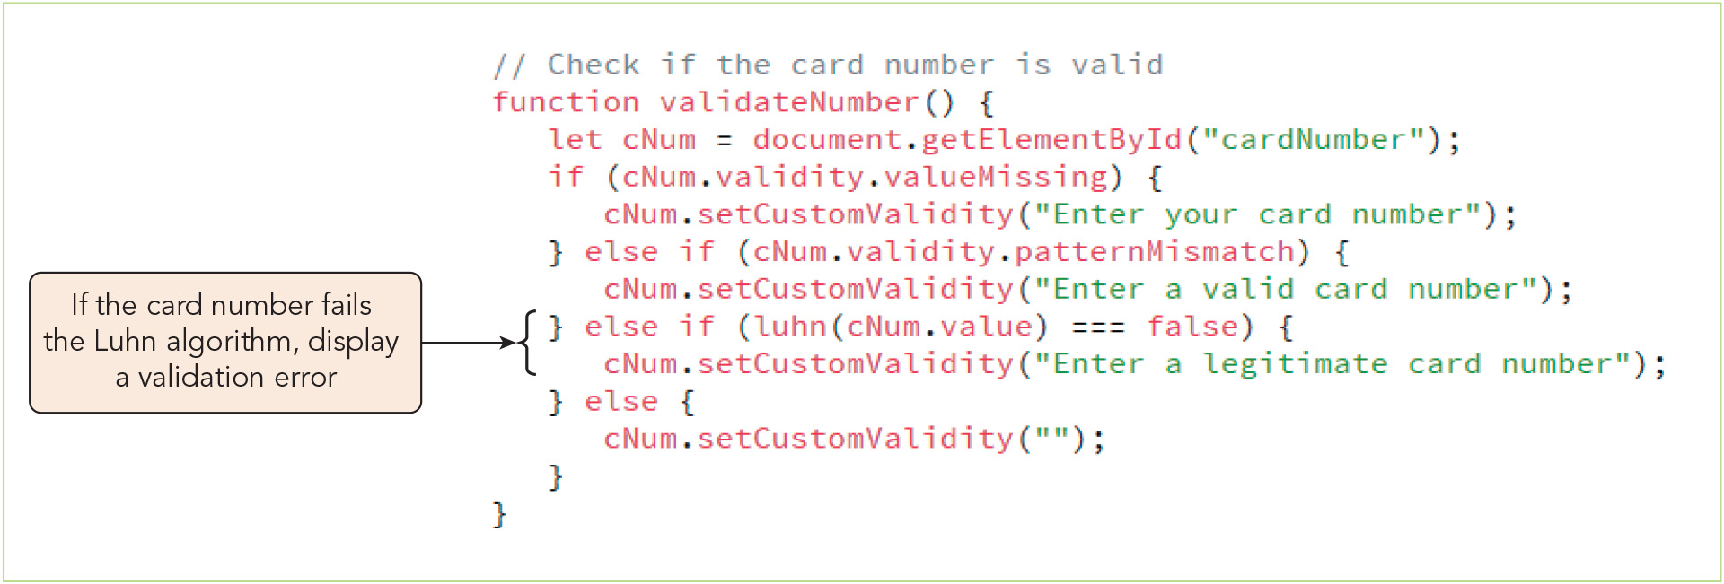
Creating a Custom Validity Check (2 of 2)
Figure 6-36 Validating the credit card number

Slide 48
Managing Form Validation (1 of 3)
You can disable the native browser validation tools and supply a custom validation framework (e.g., to support older browsers that do not provide validation or to avoid the browser's error bubbles)
Syntax to disable built-in browser validation: form.noValidate = true;
Alternatively, you can add an event listener to run an anonymous function that calls the preventDefault() method on the associated event object when it hears an invalid event
Event object: the object associated with an event captured by the script

Slide 49
Managing Form Validation (2 of 3)
You can also disable the built-in validation tools and write a set of procedures to run in response to the submit event for the web form, e.g.: form.onsubmit = myValidation; function myValidation(e) { e.preventDefault(); commands to determine if form passes validation if (form is valid) { commands run when form passes validation return true; } else { commands run when form doesn’t pass validation return false; }

Slide 50
Managing Form Validation (3 of 3)
Designing an e-commerce website
Provide guests with easy access to your catalog
Provide robust search tools
Make the purchase process easy to navigate
Show discount options and membership deals up front
Use validation tests and security measures
Incorporate social media

Slide 51
Activity 6.3: Discussion Questions
Describe the properties and methods of the form object.
Why is the input element the most commonly used form element?
Notes:
Instructions:
Use the Discussion activity to encourage group conversation about a related topic of interest.

Slide 52
Self-Assessment
Do you enjoy working with web forms using HTML, CSS, and/or JavaScript? Why or why not? How likely is it that you will work with forms regularly in your future career?
Which, if any, of the validation approaches described in Chapter 6 have you used before? Which do you expect to be in most frequent use in the category or area of web development that most interests you? Why?
As a website user, which forms of user notifications related to invalid entries do you find most and least helpful to you when completing and submitting a web form?
Notes:
Instructions:
Use the Self-Assessment question to encourage students to evaluate their progress or goals in the course, as well as determine how they might apply their learning or grow as an individual.

Slide 53
Summary
Now that the lesson has ended, you should have learned to:
Use JavaScript to reference forms and form elements.
Retrieve values from selection lists.
Retrieve values from option buttons.
Format numeric values and currency values based on local standards.
Write scripts that respond to form events.
Store values in hidden fields.
Understand how web forms are submitted for validation.
Validate web form fields using customized tools.
Test a field value against a regular expression.
Create a customized validation check for credit card data.
Manage the form validation process.
Notes:
Instructions: Reiterate the learning objectives for the lesson. Students should use this information to guide their studies and reinforcement of new concepts.

